Slide 2
diffusion /dɪˈfjuːʒn/ n. 扩散
concentration /ˌkɑːnsnˈtreɪʃn/ n. 浓度
concentration gradient/ˈɡreɪdiənt/ n. 浓度梯度
oxygen /ˈɒksɪdʒən/ n. 氧气
carbon dioxide /ˌkɑːbən daɪˈɒksaɪd/ 二氧化碳
passive transport 被动运输
active transport 主动运输
Surface area to volume ratio /ˈvɒljuːm//ˈreɪʃiəʊ/ 表面积体积比
osmosis /ɒzˈməʊsɪs/ 渗透
semi/partially-permeable membrane /ˈsemi/ /ˈpɑːʃəli/半透膜
dilute /daɪˈluːt/ adj. 稀释的

Slide 3
facilitated diffusion /fəˈsɪlɪteɪtɪd/ 协助扩散
endocytosis /ˌendoʊsaɪˈtoʊsɪs/ 胞吞作用
exocytosis /ˌeksoʊsaɪˈtoʊsɪs/ 胞吐作用
bulk transport /bʌlk/批量运输
hydrophobic /ˌhaɪdrəˈfoʊbɪk/ 疏水的
hydrophilic /ˌhaɪdrəˈfɪlɪk/亲水的
hypertonic /ˌhaɪpərˈtɑːnɪk/ 高渗的
hypotonic / ˌhaɪpə'tɒnɪk]/ 低渗的
isotonic /ˌaɪsəʊˈtɒnɪk/ 等渗的

Slide 4
plasmolysis /plæzˈmɒləsɪs/[植] 质壁分离
flaccid /ˈflæsɪd/蔫软的
turgid /ˈtɜːdʒɪd/肿胀的
water potential /pəˈtenʃ(ə)l/ 水势

Slide 5
Notes:
Teacher notes
In ‘Slide Show’ mode, click the name of a section to jump straight to that slide.

Slide 6

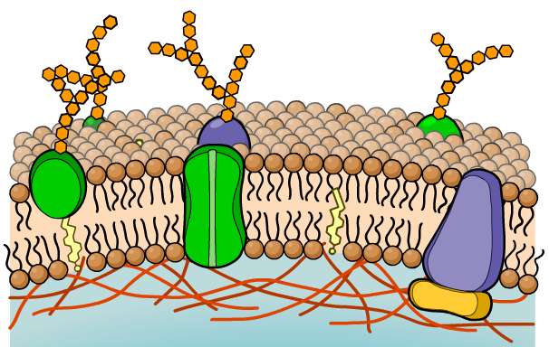

Transport across the cell membrane
All cells are surrounded by a partially-permeable membrane that controls what substances can enter and exit the cell.
A cell needs to be able to import the substances it needs to survive, and to export waste materials and substances that are needed outside the cell.
There are several methods by which substances (molecules and ions) can cross the cell membrane:
diffusion
osmosis
active transport.
Notes:
Teacher notes
See the ‘Cell Membranes’ presentation for more information about the structure and function of cell membranes.

Slide 7
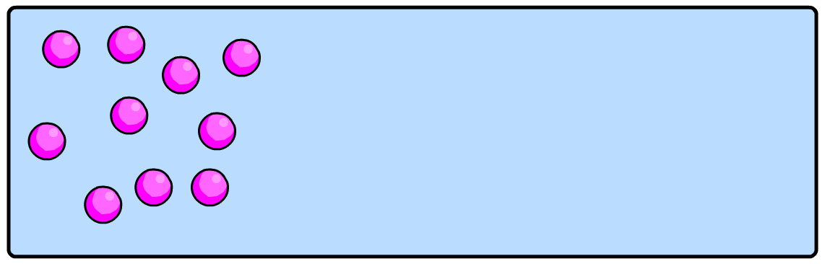
What is diffusion?
Diffusion is the net movement of particles down a concentration gradient: from a region of high concentration to a region of low concentration.
net movement
of particles
No metabolic energy is expended during diffusion so it is an example of passive transport. molecules tend to reach an equilibrium situation
One example of diffusion is gas exchange across respiratory surfaces, such as the lungs of mammals and birds, and the gills of fish.
Notes:
Teacher notes
See the ‘Gas Exchange’ presentation for more information about adaptations of the lungs and other exchange systems for diffusion.
net movement:molecules move in both directions, more will move one way than the other depending on the gradient

Slide 8
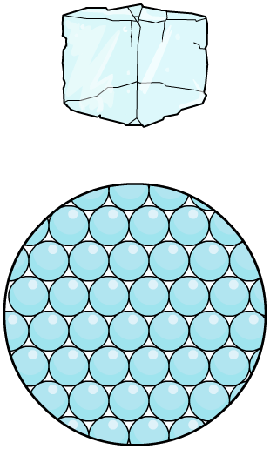
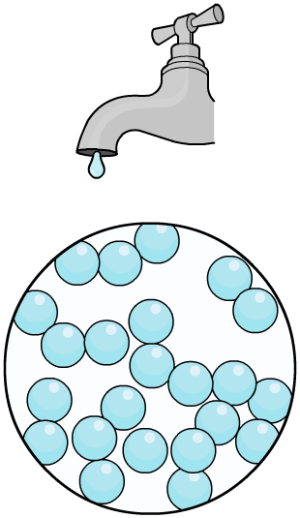
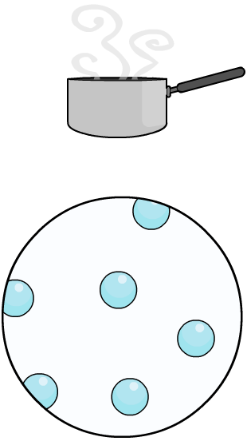
Moving molecules
In which states are molecules able to diffuse?
solid (e.g. ice)
liquid (e.g. water)
gas (e.g. steam)
Molecules in liquids and gases are constantly moving and bumping into each other. This means that they tend to spread out.

Slide 9

What factors affect diffusion?

Slide 10
The rate of diffusion
The rate of diffusion in a given direction across an exchange surface can be summarized by Fick’s law, which states that:
surface area × difference in conc.
rate of diffusion is proportional to:
length of diffusion path (membrane thickness)
Increasing the surface area across which the particles diffuse, or increasing the size of the concentration gradient will increase the rate of diffusion.
Increasing the distance (or thickness of the membrane) over which diffusion takes place will decrease the rate.
Notes:
Teacher notes
See the ‘Gas Exchange’ presentation for more information about adaptations of the lungs and other exchange systems for diffusion.

Slide 11
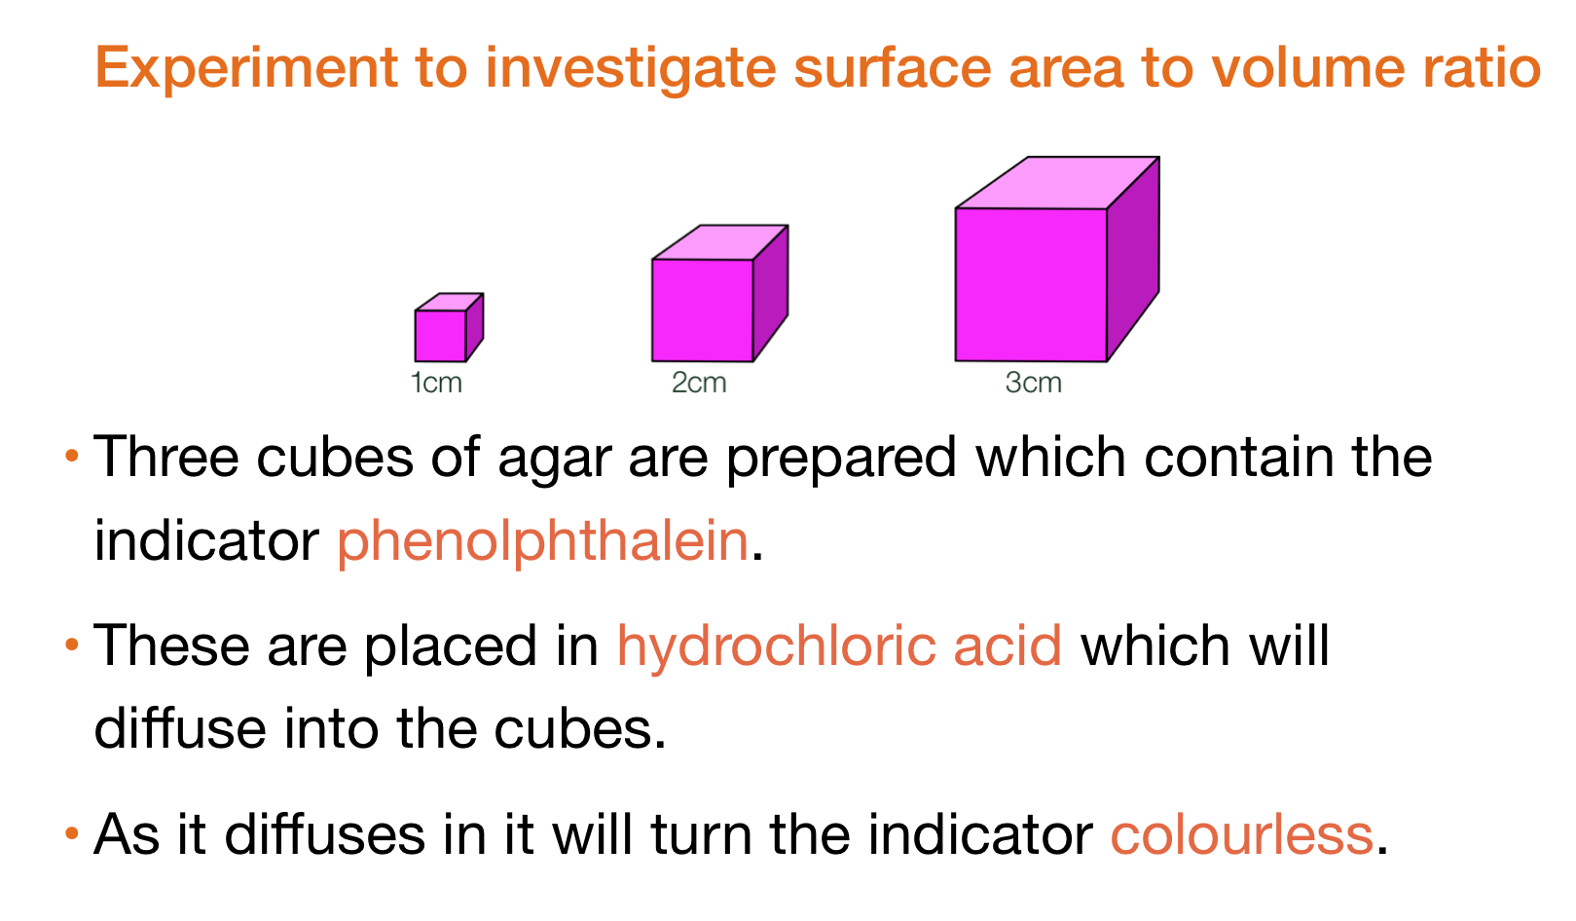
/ˌfiːnɒlˈ(f)θæliːn/酚酞

Slide 12
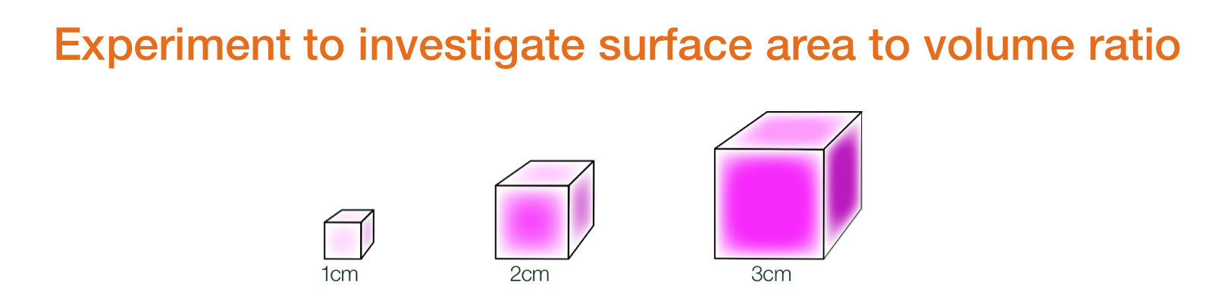

Slide 13
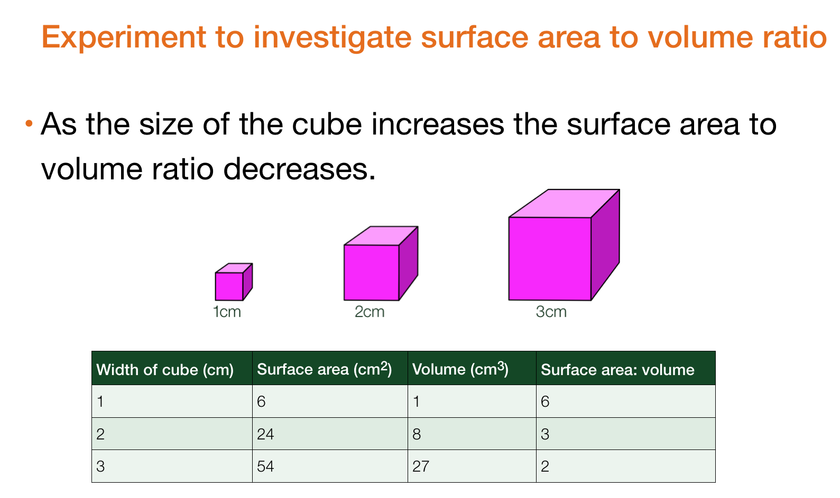
The bigger SA，the faster the diffusion

Slide 14
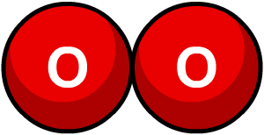
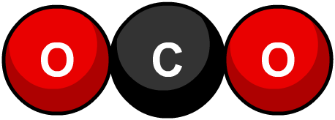
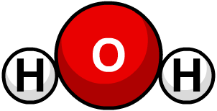
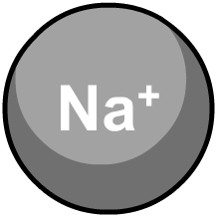
Cell membranes, polarity and diffusion
The non-polar, hydrophobic tails of phospholipid molecules in a cell membrane act as a barrier to most substances.
Generally, the smaller and less polar a molecule, the easier and faster it will diffuse across a cell membrane.
Small, non-polar molecules such as oxygen and carbon dioxide rapidly diffuse across a membrane.
Small, polar molecules, such as water and urea, also diffuse across, but much more slowly.
Charged particles (ions) cannot diffuse across a membrane, even if they are very small.

Slide 15
Facilitated diffusion
Notes:
Teacher notes
Ions travel down an electrochemical gradient, rather than a concentration gradient.

Slide 16
Diffusion

Slide 17
Notes:
Teacher notes
In ‘Slide Show’ mode, click the name of a section to jump straight to that slide.

Slide 18
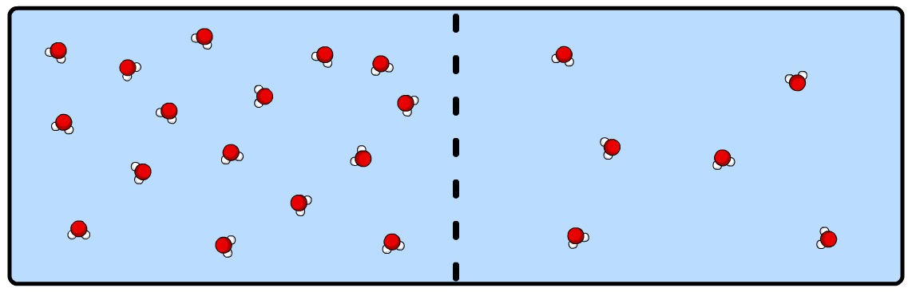
What is osmosis?
Osmosis is the diffusion of water. It is the net movement of water molecules from a region of high water potential to a region of low water potential, through a partially-permeable membrane.
net movement of water molecules
Osmosis is the process by which cells exchange water with their environment, such as in the mammalian kidney.
Notes:
Teacher notes
When discussing osmosis, a partially-permeable membrane is one that is permeable to water molecules but not larger solute molecules.

Slide 19
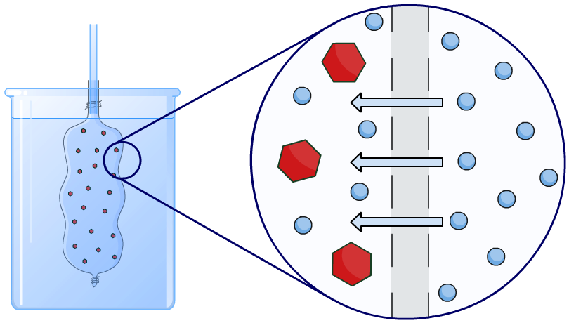
What is osmosis?
A partially-permeable membrane permit water molecules through. Osmosis can be demonstrated using visking tubing filled with a solution and placed in a beaker of pure water.
partially- permeable
membrane
(visking tubing)
water
glucose

Slide 20
What is water potential?
The net movement of water by osmosis is determined by differences in water potential between two solutions connected by a partially-permeable membrane.
Water potential is the tendency of water molecules in a system to move. It is denoted by the symbol Ψ and is measured in kiloPascals (kPa).
Pure water has the highest water potential, and has a value of 0 kPa. Solutions have a lower water potential than pure water, and have a negative water potential.
Water molecules always move from a region of high water potential to a region of low (more negative) water potential.

Slide 21
Water movement during osmosis

Slide 22
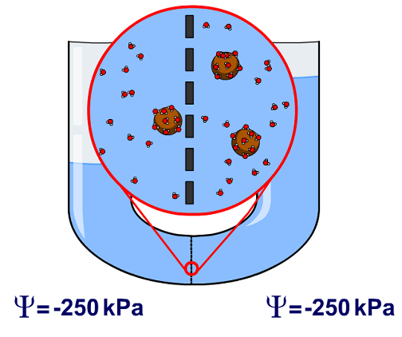
Water will move until the water potential is the same throughout the system, at which point you can say that equilibrium has been reached

Slide 23
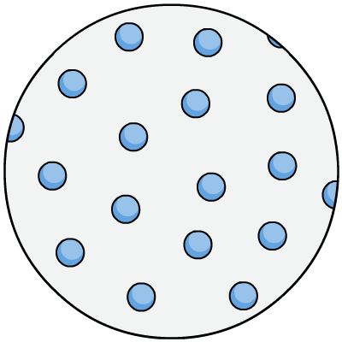
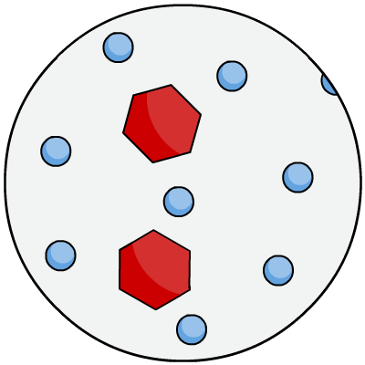
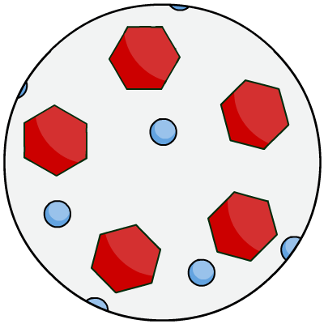
Dilute vs concentrated
solute溶质 + solvent溶剂 = solution
During osmosis, water molecules diffuse from pure water or dilute solution to more concentrated solutions.
Dilute solutions have a high concentration of water molecules.
Concentrated solutions have a low concentration of water molecules.
concentrated
solution
pure water
dilute solution

Slide 24
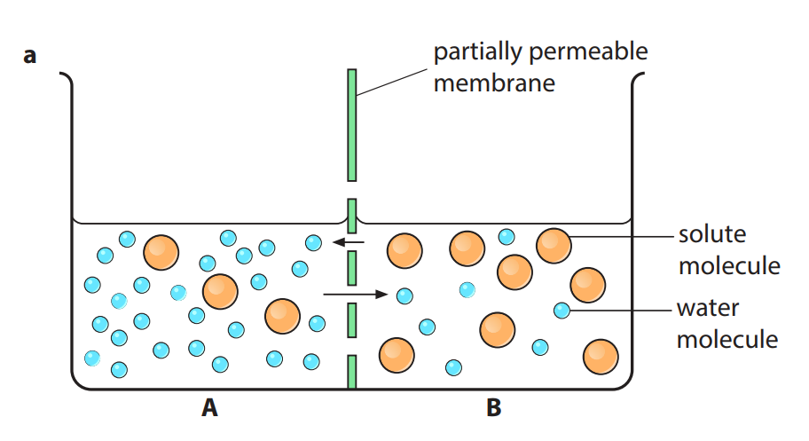
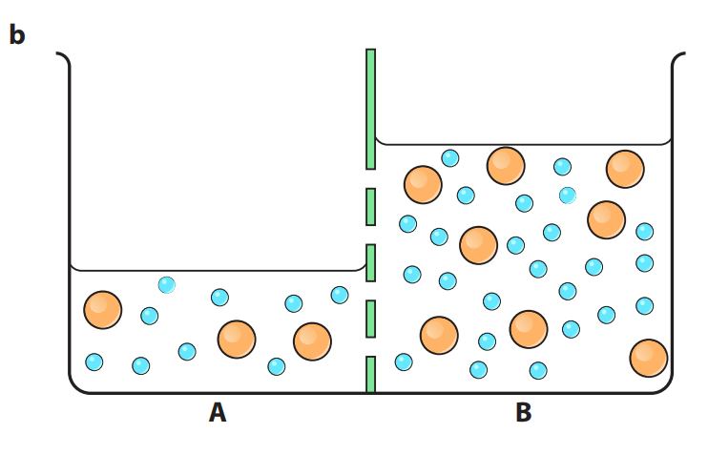
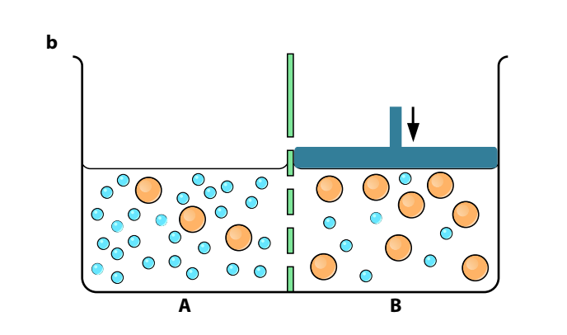
Water potential depends on two factors:
• the concentration of the solution
• how much pressure is applied to it.
before
Applying pressure to solution B
solution A ：
solution B:
water:
‘squeeze’ water back into solution A
increasing the tendency for water form B to A
increasing B water potential
Pressure on a solution increases
its water potential.
higher water potential
low water potential
higher to lower

Slide 25
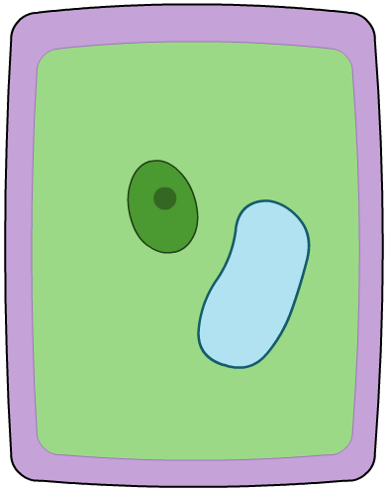

Osmosis and cells
Plant and animal cells are surrounded by a partially-permeable plasma membrane. This allows water and other small molecules to diffuse across.
Plant cells have a strong cell wall surrounding the membrane which offers support and protection,fully permeable
plasma
membrane
cell wall
red blood cell
plant cell

Slide 26
Osmosis in plant cells

Slide 27
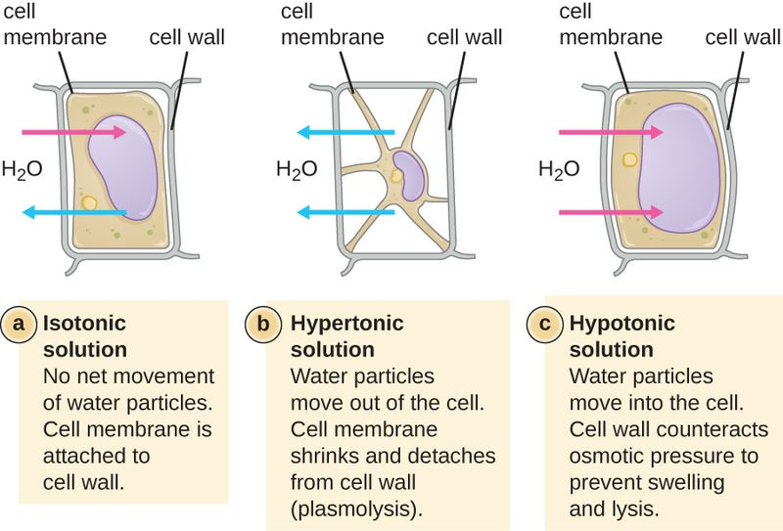
Osmosis and plant cells
same concentrated solution
concentrated solution
dilute solution
Notes:
Teacher notes
This activity could be used to check students’ understanding of the effects of osmosis on plant cells.

Slide 28
plant cell in pure water
pure water has a water potential that is higher than cells
net movement of water into cells by osmosis through their partially permeable cell surface membranes.
as water enters, the volume of the protoplasts increases
increases the water potential of the cells.
until equilibrium is reached when the contents of the cells reach the same water potential as the water.
cells will then be turgid.

Slide 29
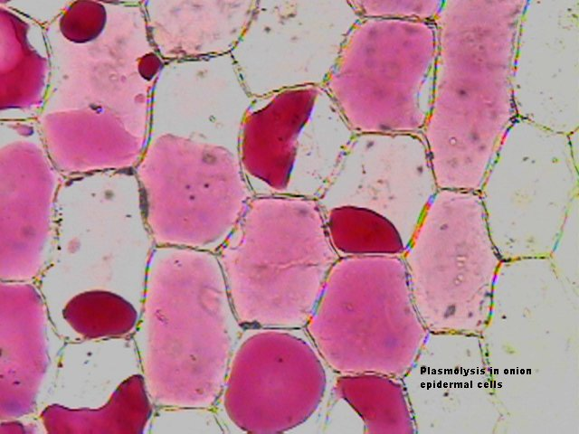
plasmolysis
solution has a lower water potential than that of cells
net movement of water out of cells by osmosis through their partially permeable cell surface membranes.
the protoplasts shrink ，this decreases the water potential of the cells.
incipient plasmolysis.
As shrinkage continues, the protoplasts pull away from the cell walls – this is plasmolysis.
Equilibrium is reached when the water potential of the cells equals that of the sucrose solution

Slide 30
Osmosis in animal cells

Slide 31
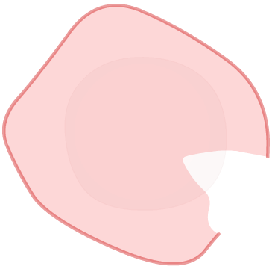

Osmosis and animal cells
Animal cells do not have a cell wall.
In dilute solutions, osmosis can cause animals cells to swell up膨胀 and burst / lyse.
called lysis 溶解
In concentrated solutions, water loss causes the cells to shrink.
called crenation

Slide 32

Water potential of potatoes

Slide 33
Osmosis: true or false?

Slide 34
Direction of water movement

Slide 35
Notes:
Teacher notes
In ‘Slide Show’ mode, click the name of a section to jump straight to that slide.

Slide 36
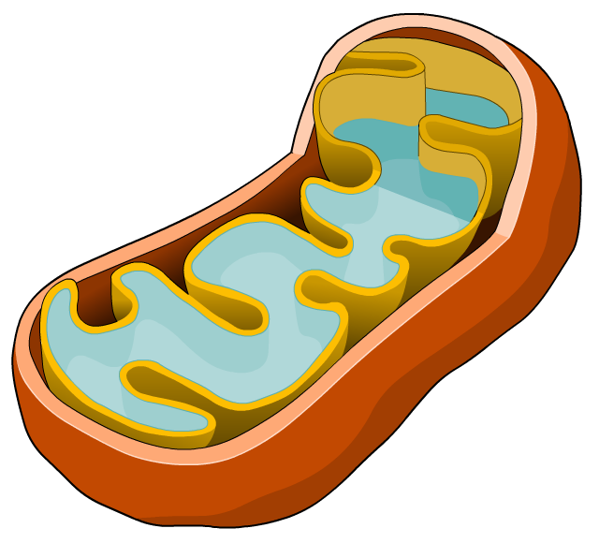
What is active transport?
Movement of molecules or ions through transport
proteins, across a cell membrane, against their
concentration gradient, using energy from ATP
This process requires the expenditure of energy in the form of ATP (adenosine triphosphate), a molecule produced by respiration in mitochondria.
Notes:
Teacher notes
See the ‘Cell Structure’ presentation for more information about mitochondria.

Slide 37
Active transport
Notes:
Teacher notes
ATP loses a phosphate group (in a hydrolysis reaction) to become adenosine diphosphate (ADP).

Slide 38
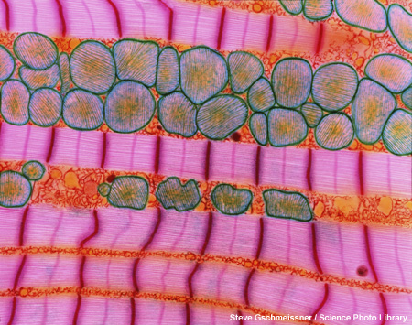
Examples of active transport
Active transport is used in many processes, such as the:
uptake of glucose and amino acids in the small intestine
absorption of mineral ions by plant roots
excretion of hydrogen ions and urea by kidneys
exchange of sodium and potassium ions in neurons and muscle cells.
Cells that undertake active transport on a large scale have many mitochondria.

Slide 39
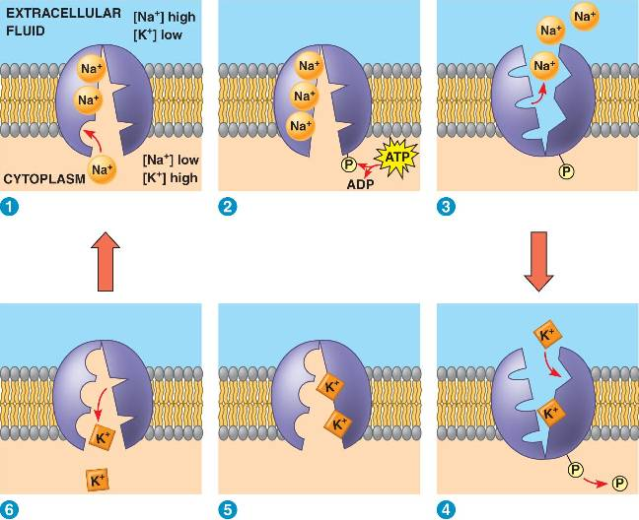
sodium-potassium pump

Slide 40
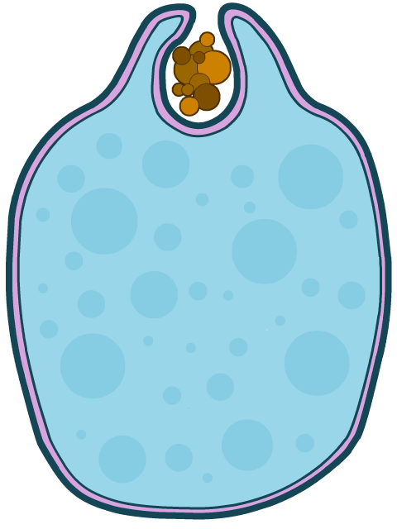
What is bulk transport?
A type of active transport where large molecules are
transported across the cell surface membrane, using
energy from ATP.
The two types of bulk transport are endocytosis and exocytosis, and they involve changes to the membrane shape.
Endocytosis is the bulk transport of material in to the cell, and can be split into three processes: phagocytosis, pinocytosis and receptor-mediated endocytosis.
Exocytosis is the bulk transport of material out of the cell – essentially the reverse of endocytosis.

Slide 41
Mechanisms of endocytosis

Slide 42
Exocytosis

Slide 43
Notes:
Teacher notes
In ‘Slide Show’ mode, click the name of a section to jump straight to that slide.

Slide 44
Glossary

Slide 45
What’s the keyword?

Slide 46
Comparing methods of transport

Slide 47
Multiple-choice quiz

